Slide 1

AtliQ Hardware
Sale & Finance Analytics of
AtliQ Hardware

Slide 2
Analytics Overview and Insights: Atliq Hardware
Business Domain Knowledge of Atliq Hardware
Types of Customers of Atliq Hardware
Sales Channels of Atliq Hardware
ETL Process
Loading of Data in Queries & Connections
Data Modelling
DAX (Data Analysis Expressions)
Overview of Sales Analytics at Atliq Hardware
Key Insights from Sales Analytics of Atliq Hardware
Customer Net Sales Performance
Margin Performance vs Target Performance
Top 10 Atliq Hardware Products or Items in 2021 vs 2020
Division Level Report
Top and Bottom 5 Selling Products Based on Quantity
New Products Introduced by Atliq Hardware in 2021
Overview of Finance Analytics at Atliq Hardware
Key Insights from Finance Analytics of Atliq Hardware
P&L by FY: Company's Net Sales, Cost of Goods Sold (COGS), and Gross Margin & Gross Margin % by FY
Profit and Loss (P&L) Statement for AtliQ Hardwares for the Fiscal Year (FY) 2021
P&L by FY and Quarters
Gross Margin Percentage by Quarters

Slide 3
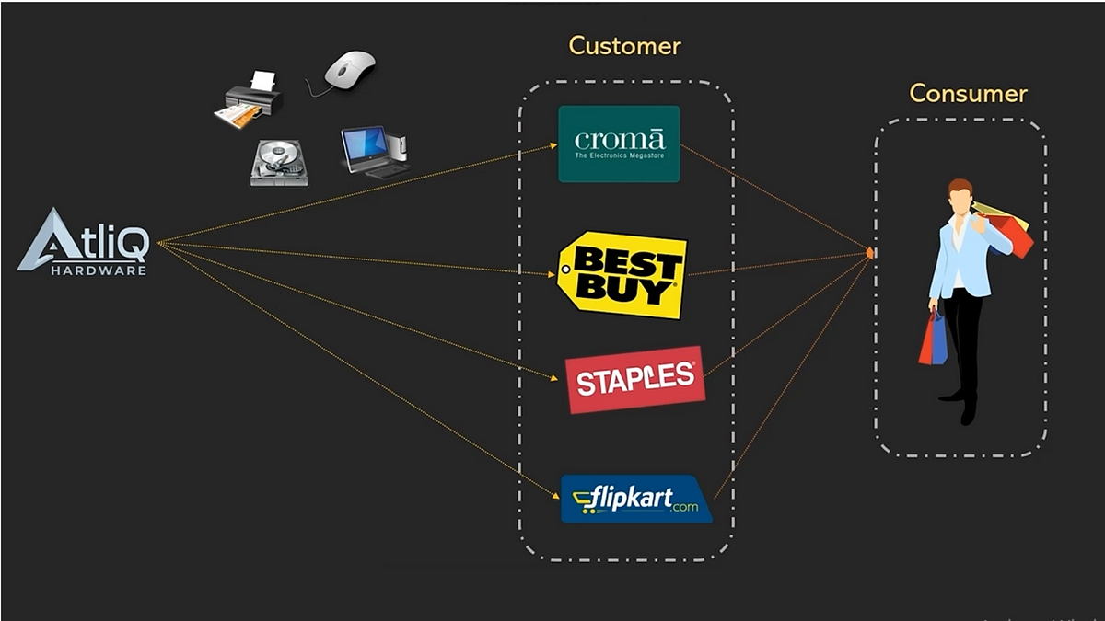
AtliQ Hardware is a company that specializes in manufacturing hardware products such as PCs, printers, mouse, keyboards, and more. They distribute their products to various customers such as Amazon, Flipkart, Best Buy, and Croma, who in turn sell them to end consumers. AtliQ Hardware operates its own manufacturing facilities where they produce and supply their range of products to their customers. The company has expanded its business presence to multiple countries. The fiscal year for Atliq Hardware begins in September and ends in August.

Slide 4

AtliQ Hardware serves two distinct customer segments:-
Brick-and-mortar retailers:- Physical stores like Best Buy and Croma form the backbone of our traditional retail partnerships.
E-commerce platforms:- Online giants such as Flipkart and Amazon are pivotal in our digital commerce ecosystem.
By leveraging both brick-and-mortar and e-commerce channels, AtliQ Hardware maximizes its market presence and ensures accessibility to customers across different retail landscapes

Slide 5
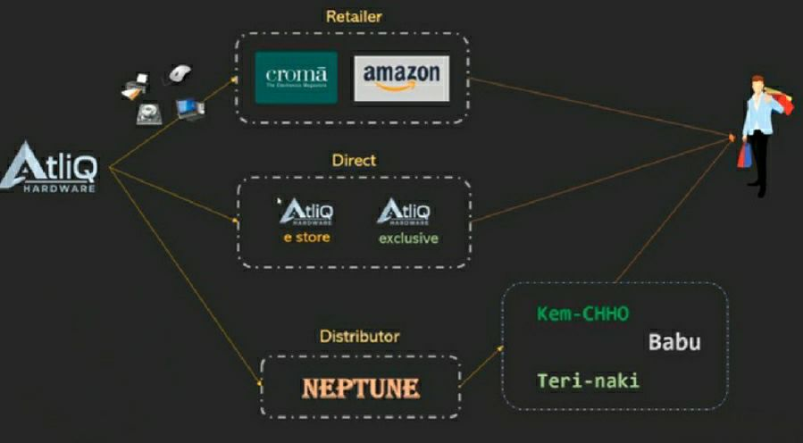
AtliQ Hardware operates through three main sales channels:-
Retailer Channel:- AtliQ Hardware collaborates with renowned retailers such as Croma, Amazon, Best Buy, and more to make products accessible to a wide consumer base.
Direct Channel:- AtliQ Exclusive and AtliQ E-store platforms provide direct access to consumers, offering convenience and personalized service.
Distributor Channel:- Distributors like Neptune, Sage facilitate the distribution of AtliQ Hardware products to stores in various cities, ensuring widespread availability.

Slide 6
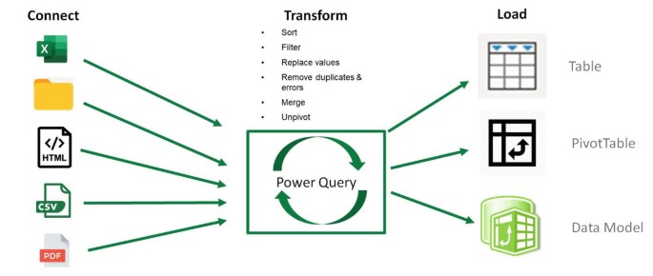
ETL PROCESS:-
We will begin by extracting the file in CSV format as part of the ETL (Extract, Transform, Load) process. Next, we will transfer the sales data from AtliQ Hardware into Power Query. Within Power Query, we will perform the necessary transformations based on the specified requirements. After the data is transformed, we will load it into the data model. From there, we can generate numerous reports using Pivot Tables and Power Pivot DAX measures to analyze the data effectively.

Slide 7
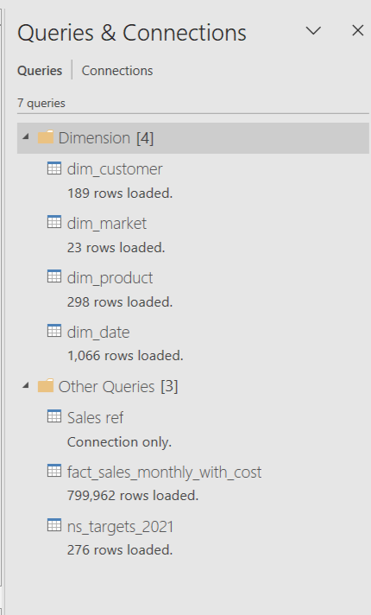
We have successfully loaded the following tables:-
dim_customer
dim_market
dim_product
dim_date
fact_sales_monthly_with_cost
ns_targets_2021
Additionally, we utilized the "Sales ref" table solely for establishing connections. All of this data was provided by the AtliQ Data Engineering team. It's worth noting that we created the dim_date table ourselves.
These seven queries seem to be combining information from various tables. We can leverage this data for analytics purposes.

Slide 8
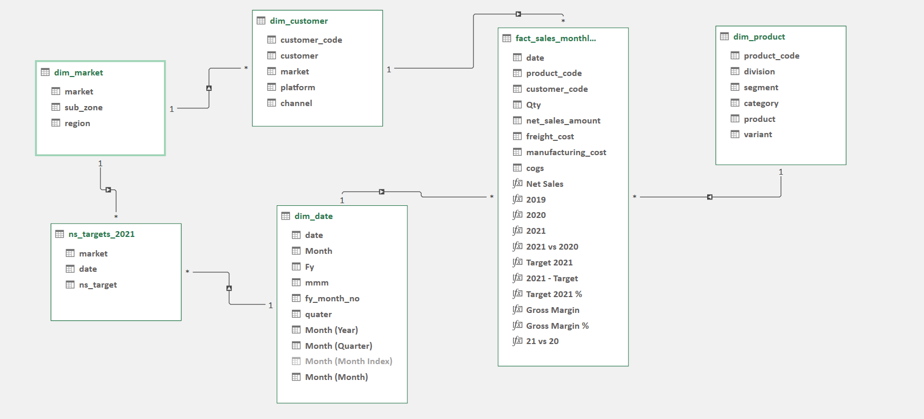
Data Modelling :-
Data modeling is the process of creating a visual representation of data objects and their relationships. It's a crucial step in designing and maintaining a database.
The star schema in the image consists of a central fact table, surrounded by several dimension tables. The fact table typically contains large amounts of data that is measured over time, such as sales transactions. The dimension tables contain smaller amounts of data that provide context for the facts, such as customers, products, dates, and markets. The relationships between the tables are shown by lines. Each line represents a foreign key, which is a column in one table that references the primary key of another table. For example, the customer_code column in the fact_sales_monthly table is a foreign key that references the customer_code column in the dim_customer table.

Slide 9
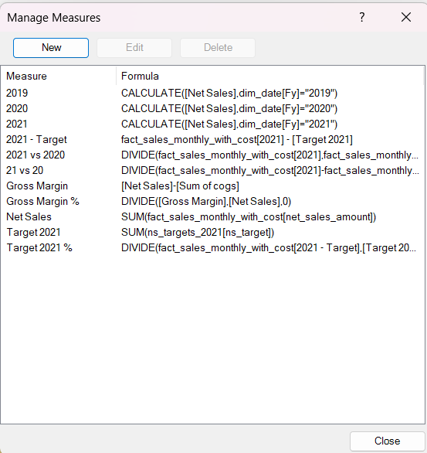
DAX (Data Analysis Expressions) is a formula language used for data modeling and analysis in Microsoft Power BI and Excel Power Pivot, enabling calculations, aggregation, and manipulation of data within tables and visualizations.
We have created several DAX measures for analytics:-
2019, 2020, 2021:- These measures calculate the net sales for each year by filtering the fact_sales_monthly_with_cost table by the dim_date[Fy] field.
2021 - Target, 2021 vs 2020, 21 vs 20 :- These measures compare the sales for 2021 to a target, the sales for 2021 to the sales for 2020, and the sales for the current month to the sales for the previous month.
Gross Margin, Gross Margin % :- These measures calculate the gross margin and gross margin percentage by subtracting the sum of the cost of goods sold (COGS) from the net sales and then dividing by the net sales.
Net Sales:- This measure calculates the total net sales by summing the net_sales_amount field in the table.
Target 2021, Target 2021%:- These measures calculate the target sales for 2021 and the target sales percentage for 2021 by summing the ns_target field in the ns_targets_2021 table
It is important to note that these are just a few of the measures that you can create with DAX. DAX is a powerful language that can be used to create a wide variety of measures for data analysis.

Slide 10
Sales Analytics :-
Sales analytics is the process of collecting, analyzing, and interpreting data related to your sales activities to gain valuable insights that can improve your sales performance and profitability. Sale analytics for Atliq Hardware would typically involve gathering, analyzing, and interpreting data related to the sales performance of hardware products offered by Atliq.
Here's a breakdown of functional knowledge in sale analytics for Atliq Hardware:-
Data Collection: Gathering sales data from various sources such as POS (Point of Sale) systems, online sales platforms, CRM (Customer Relationship Management) software, and other relevant databases. This data would include information such as sales volume, revenue, product categories, customer demographics, geographic locations, etc.
Data Cleaning and Preprocessing: Ensuring that the collected data is accurate, consistent, and free from errors or inconsistencies. This may involve removing duplicates, handling missing values, standardizing formats, and other data preprocessing tasks to prepare the data for analysis.
Data Analysis: Using statistical and analytical techniques to analyze the sales data and identify patterns, trends, correlations, and insights. This may involve techniques such as descriptive statistics, correlation analysis, regression analysis, time series analysis, and data visualization to gain a deeper understanding of sales performance.

Slide 11
Sales Performance Metrics: Calculating key performance indicators (KPIs) and metrics to assess the performance of Atliq Hardware's sales efforts. Common sales metrics may include total sales revenue, sales growth rate, average transaction value, customer acquisition cost, customer retention rate, sales conversion rate, etc.
Product Performance Analysis: Analyzing the sales performance of individual hardware products or product categories to identify top-selling products, identify underperforming products, assess product profitability, and make data-driven decisions related to product assortment, pricing, and inventory management.
Customer Segmentation: Segmenting customers based on various criteria such as demographics, purchase behavior, buying frequency, geographic location, etc. This allows Atliq Hardware to better understand their customer base, target specific customer segments with tailored marketing strategies, and optimize sales efforts.
Sales Performance Reporting: Creating comprehensive reports and dashboards to communicate key findings, insights, and recommendations derived from sales analytics to relevant stakeholders within Atliq Hardware, including sales teams, marketing teams, senior management, and other decision-makers.
Continuous Improvement: Continuously monitoring and evaluating sales performance metrics, refining analytical models, and adapting sales strategies based on changing market conditions, customer preferences, and business objectives to drive continuous improvement in sales effectiveness and efficiency.
By leveraging sale analytics effectively, Atliq Hardware can gain valuable insights into their sales performance, identify opportunities for growth, optimize sales strategies, and ultimately enhance overall business performance.

Slide 12
Key Insights from
Sales Analytics of
Atliq Hardware

Slide 13
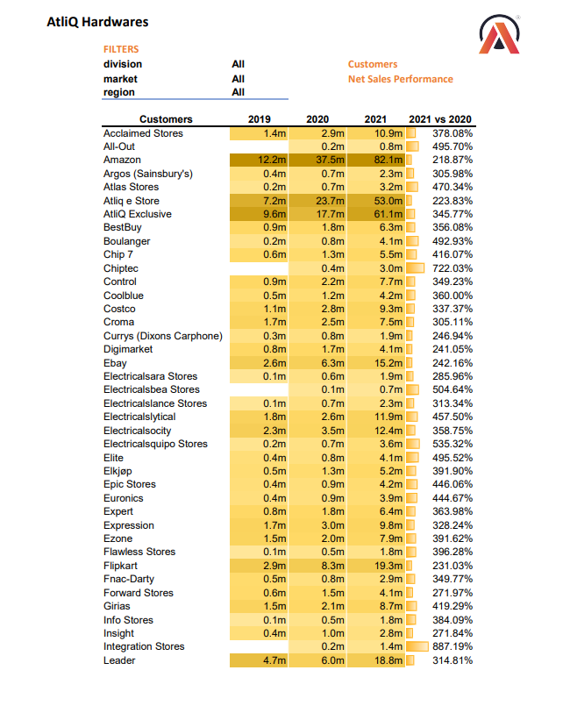
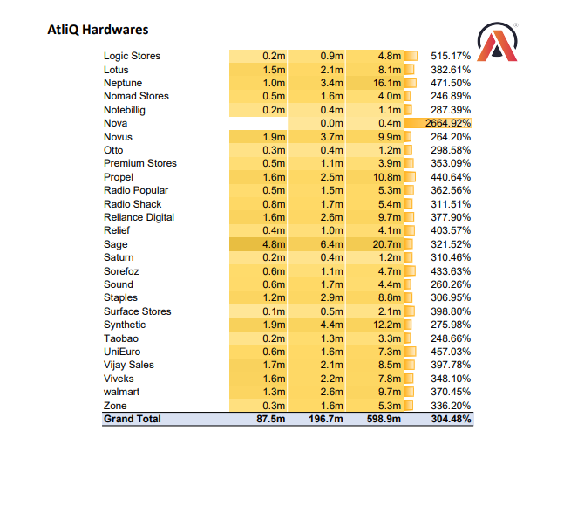
We have prepared a report on the net sales performance of Atliq Hardware's customers. The report includes a column listing all the customers to whom Atliq Hardware sells its products. Using Data Analysis Expressions (DAX), we have generated several measures to analyze the net sales data of each customers in particular year like:-
2019 Net Sales
2020 Net Sales
2021 Net Sales
2020 vs. 2019 Comparison Net Sales
This report indicates a clear trend of increasing net sales for customers year over year.
We have the capability to utilize filter options to examine the net sales of specific markets or countries within a particular division. Additionally, we can apply filters to isolate net sales data from specific regions based on our requirements.

Slide 14
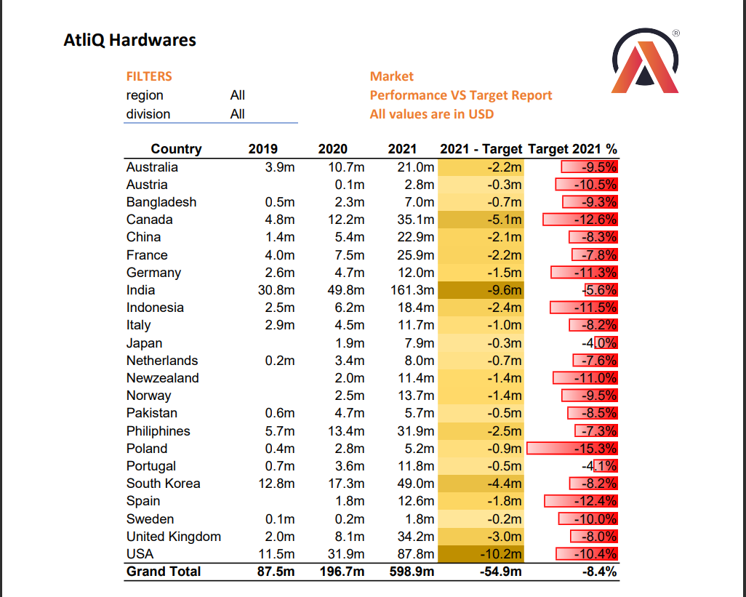
The report shows the performance of AtliQ Hardwares sales in various countries from 2019 to 2021. It also shows the target sales for 2021 and the percentage difference between actual sales and target sales.
Here are some key takeaways from the report:-
Overall, AtliQ Hardwares' filter sales grew significantly from 2019 to 2021, increasing from USD 87.5 million to USD 598.9 million.
However, sales in 2021 fell short of the target by USD 54.9 million, or 8.4%.
The largest shortfalls relative to target were in the United States, India, Canada, and the Philippines.

Slide 15
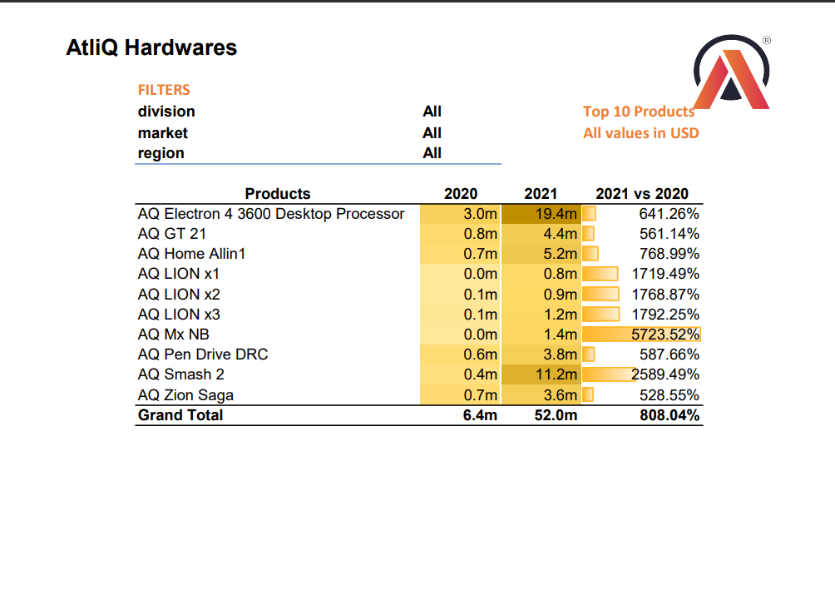
The report shows the top 10 Atliq hardware products or items in 2021 vs 2020
FOR EXAMPLE:-
AQ MX NB: It increased from 0.0 million USD in 2020 to 1.4 million USD in 2021, which is an increase of 5723.52%.
AQ Smash 2: It increased from 0.4 million USD in 2020 to 11.2 million USD in 2021, which is an increase of 2589.49%.
Overall, Atliq hardware sales increased by 808.04% from 2020 to 2021.

Slide 16
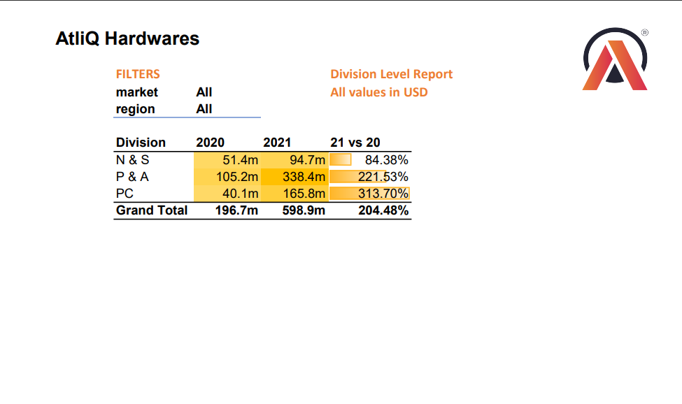
The report is a Division Level Report from AtliQ Hardwares. It shows the sales figures for the company's three divisions (N&S, P&A, and PC) for the years 2020 and 2021.
Here are some key takeaways from the report:-
All three divisions saw significant growth in sales from 2020 to 2021. N&S sales grew by 84.38%, P&A sales grew by 221.53%, and PC sales grew by 313.70%.
The P&A division was the largest contributor to sales in both 2020 and 2021. In 2021, P&A sales were more than three times higher than N&S sales and more than twice as high as PC sales.
The PC division had the highest growth rate in 2021. Its sales grew by more than 300%, compared to growth of 221.53% for P&A and 84.38% for N&S.
Overall, the report suggests that AtliQ Hardwares had a strong year in 2021, with all three of its divisions experiencing significant sales growth

Slide 17
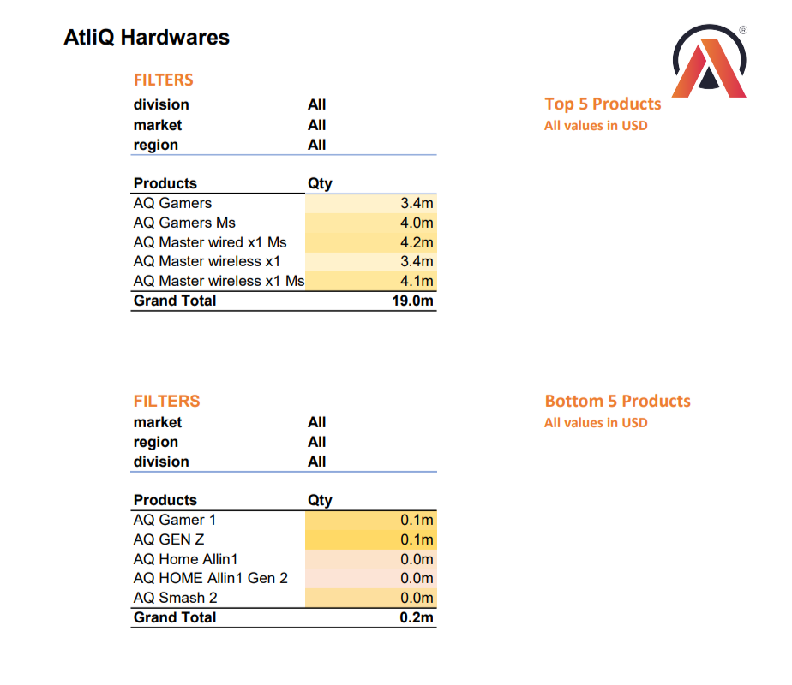
It is a sales report of AtliQ Hardwares. It shows the top and bottom 5 selling products based on quantity, as well as some additional insights from the report:-
Top 5 Selling :
AQ Gamers Ms: 4.0 million units sold
AQ Master wired x1 Ms: 3.8 million units sold
AQ Master wireless x1: 3.5 million units sold
AQ Master wireless x1 Ms: 3.2 million units sold
AQ Gamers: 3.0 million units sold
Bottom 5 Selling :
AQ Gamer 1: 0.01 million units sold
AQ GEN Z: 0.02 million units sold
AQ Home Allin1: 0.03 million units sold
AQ HOME Allin1 Gen 2: 0.04 million units sold
AQ Smash 2: 0.05 million units sold
It's important to remember that this report only provides a snapshot of sales data without additional context.

Slide 18
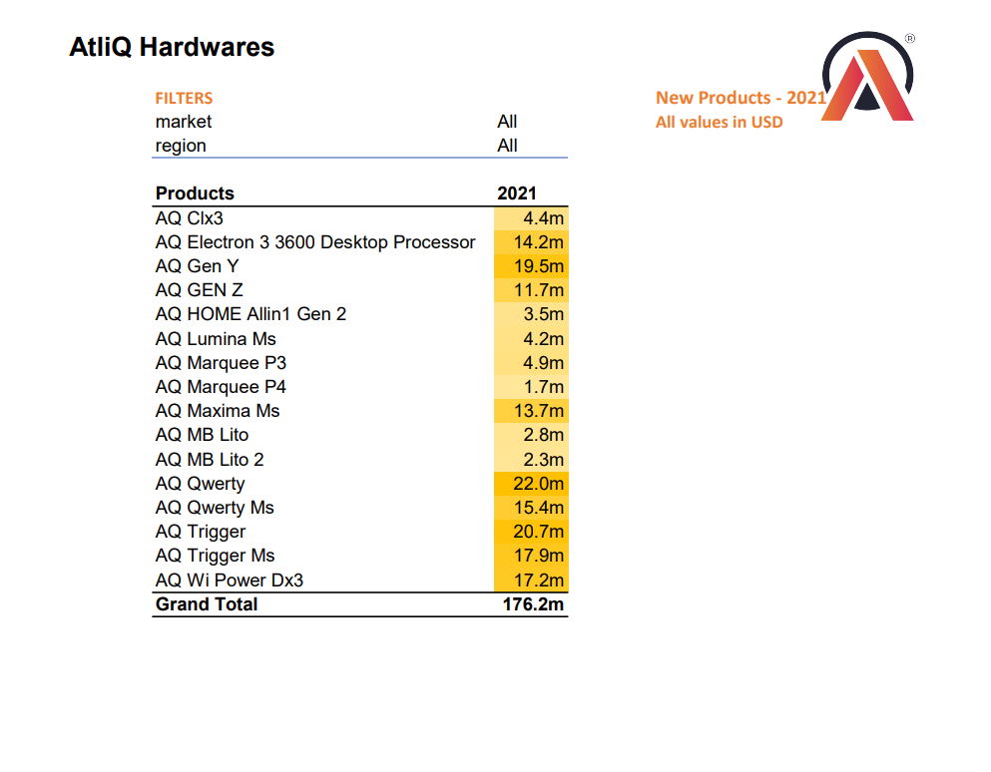
The report contains the information about the new products that Atliq began selling in 2021.
These are the only rows in the table that contain a percentage value of 0% in the "21 vs 20" column.
This suggests that these products were not sold in 2020, but began being sold in 2021.

Slide 19
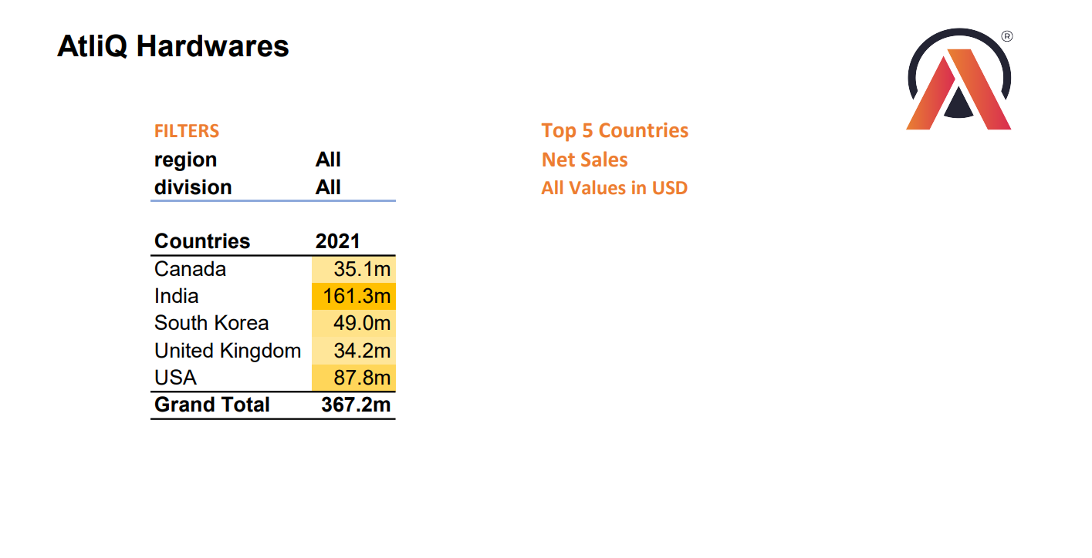
The report shows the top 5 countries in terms of net sales in 2021 are:-
USA - $87.8 million
India - $161.3 million
Canada - $35.1 million
United Kingdom - $34.2 million
South Korea - $49.0 million

Slide 20
Finance Analytics:-
Finance analytics refers to the process of using financial data and statistical techniques to analyze and interpret financial performance, make informed decisions, and drive strategic planning within an organization. It involves the application of various quantitative methods, such as financial modeling, statistical analysis, and data visualization, to understand the financial health and performance of a company.
Key metrics commonly used in finance analytics include:-
Revenue:- The total amount of money generated from sales of goods or services.
Gross Margin:- The difference between revenue and the cost of goods sold, expressed as a percentage.
Net Income:- The total profit after deducting all expenses, including operating expenses, taxes, interest, and depreciation.
EBITDA (Earnings Before Interest, Taxes, Depreciation, and Amortization):- A measure of a company's operating performance, often used to evaluate its profitability without the influence of accounting and financial decisions.
Cash Flow:- The movement of cash into and out of a business, including operating, investing, and financing activities.
Profit Margin:- The percentage of revenue that remains after all expenses have been deducted, often used to measure a company's efficiency and profitability.
In the context of Atliq Hardware, specific financial metrics may vary depending on the company's industry, size, and business model. However, these key metrics provide a foundation for evaluating financial performance and making informed decisions in finance analytics.

Slide 21
Key Insights
from
Finance Analytics
of
Atliq Hardware

Slide 22
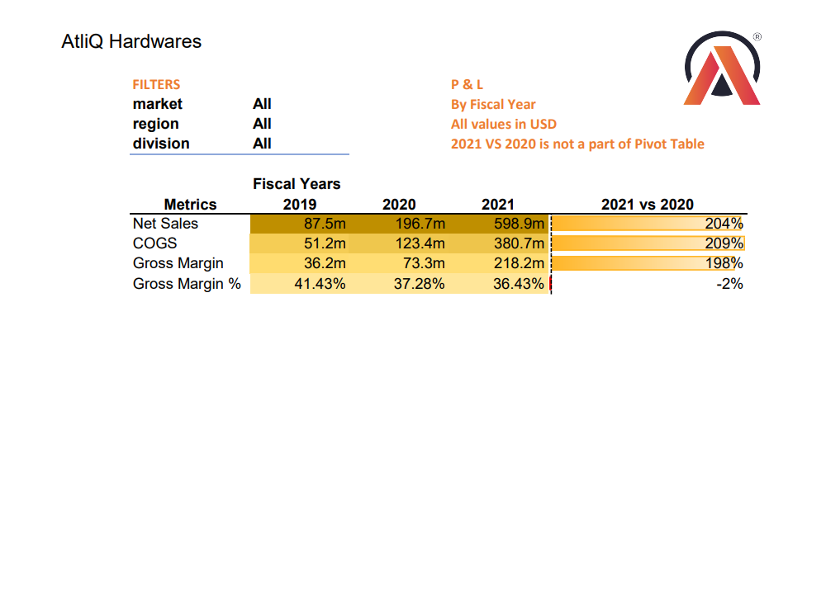
This is a financial report for a company called AtliQ Hardwares. The report shows the company's net sales, cost of goods sold (COGS), and gross margin & gross margin % by fiscal year.
Here are some key takeaways from the report:-
Net sales: Net sales increased significantly from $87.5 million in 2019 to $598.9 million in 2021, representing a growth of 204%.
Cost of goods sold (COGS): COGS also increased significantly from $51.2 million in 2019 to $380.7 million in 2021, representing a growth of 209%.
Gross margin: Gross margin increased from $36.2 million in 2019 to $218.2 million in 2021, representing a growth of 198%. However, the gross margin percentage decreased slightly from 41.43% in 2019 to 36.43% in 2021.
It is important to note that this report only shows a limited amount of information about the company's financial performance.

Slide 23
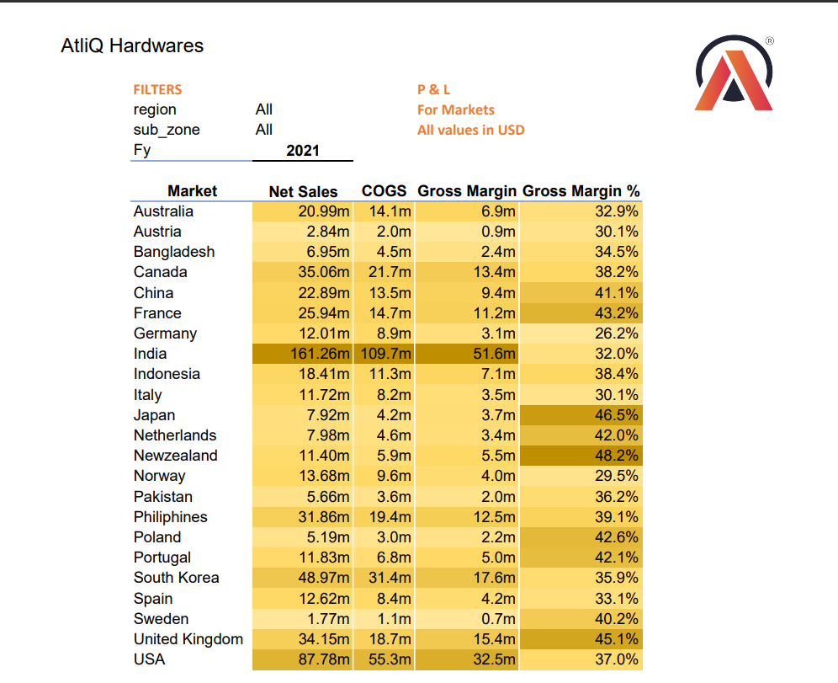
The report is a Profit and Loss (P&L) statement for AtliQ Hardwares for the fiscal year (Fy) 2021. The statement breaks down sales and cost of goods sold (COGS) by market, sub-zone, and region.
Here are some key insights from the report:-
AtliQ Hardwares' FILTERS region generated US$541.7 million in net sales in FY 2021. This represents a year-over-year growth of x%.
The company's largest market, India, generated US$161.26 million in net sales, followed by the United States with US$87.78 million and South Korea US$48.97 million & Canada with US$35.06 million.
The company's highest gross margin was in New Zealand (48.2%), Japan (46.5%) and the United Kingdom (45.1%).
The company's lowest gross margin was in Germany (26.2%), followed by Norway (29.5%) , Austria (30.1%) and Italy (30.1%).

Slide 24
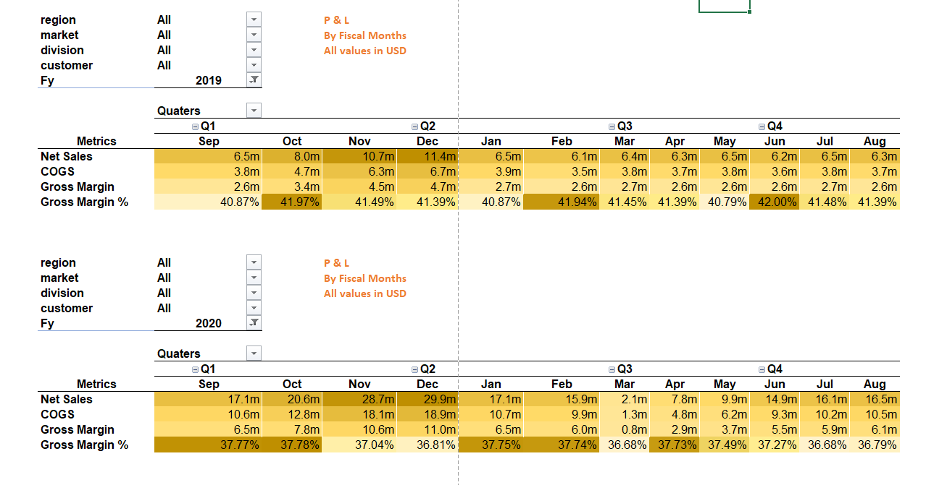
This is a financial report for two fiscal years. The report shows the net sales, cost of goods sold (COGS), and gross margin for each quarter. It also shows the gross margin percentage.
Fiscal Year 2019
Net sales started at $6.5 million in Q1 and reached $11.4 million in Q4.
COGS started at $3.8 million in Q1 and reached $6.7 million in Q4.
Gross margin started at $2.6 million in Q1 and reached $4.7 million in Q4.
Gross margin percentage ranged from 40.79% to 42.00%.
Fiscal Year 2020
Net sales started at $17.1 million in Q1 and reached $29.9 million in Q4.
COGS started at $10.6 million in Q1 and reached $18.9 million in Q4.
Gross margin started at $6.5 million in Q1 and reached $11.0 million in Q4.
Gross margin percentage ranged from 36.68% to 37.78%.
Overall, the company's net sales, COGS, and gross margin all increased in Fiscal Year 2020 compared to Fiscal Year 2019. However, the gross margin percentage decreased slightly.

Slide 25
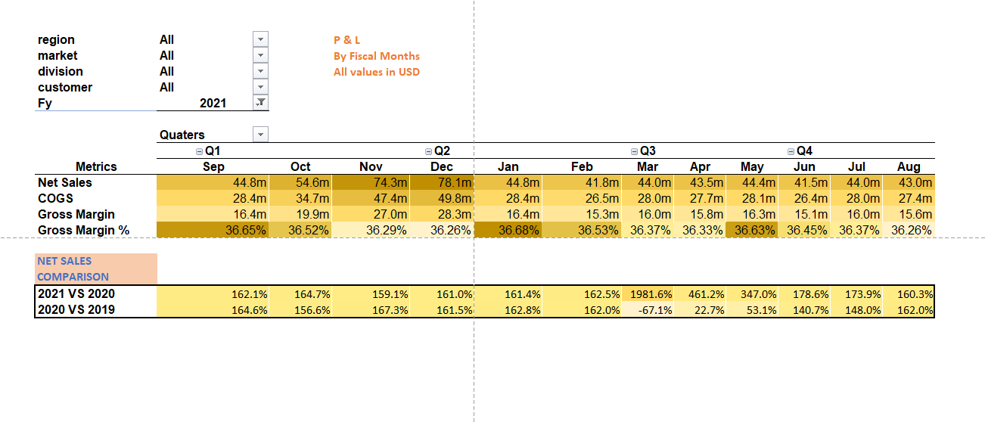
The report shows the net sales, cost of goods sold (COGS), and gross margin for each quarter for the FY 2021. It also shows the gross margin percentage.
Net sales increased significantly in 2021 compared to 2020. The company's net sales grew by over 60% in 2021, compared to the previous year. This growth was consistent throughout the year, with all four quarters showing year-over-year increases.
Gross margin remained relatively stable. The company's gross margin hovered around 36% in both 2020 and 2021. This suggests that the company was able to control its costs effectively while increasing its sales.
Sales growth was strongest in the fourth quarter of 2021. The company's net sales grew by over 190% in Q4 2021 compared to Q4 2020. This suggests that the company may have benefited from seasonal factors or promotional activities during the holiday season.

Slide 26
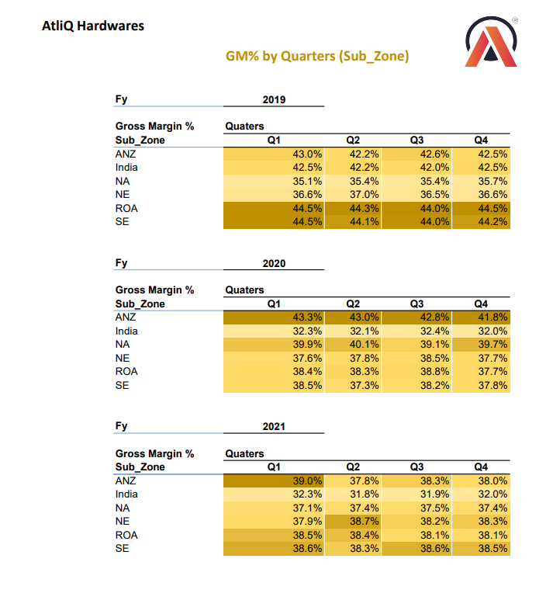
It shows the gross margin (GM) percentage for different sub-zones of AtliQ Hardwares for fiscal years (FY) 2019, 2020, and 2021.
Here are some key observations from the report:-
Overall, the GM% for all sub-zones has decreased over the three fiscal years. In FY 2019, the average GM% across all sub-zones was 42.2%, while in FY 2021, it was 37.9%.
The ANZ sub-zone has the highest GM% overall. In all three fiscal years, the ANZ sub-zone had a higher GM% than any other sub-zone.
The India sub-zone has the lowest GM% overall. In all three fiscal years, the India sub-zone had a lower GM% than any other sub-zone.
The GM% for the ANZ sub-zone has declined the most over the three fiscal years. The GM% for the ANZ sub-zone decreased by 5.0 percentage points from FY 2019 to FY 2021.
The GM% for the India sub-zone has declined the least over the three fiscal years. The GM% for the India sub-zone decreased by only 0.5 percentage points from FY 2019 to FY 2021.

Slide 27
Conclusion:-
In summary, the insights gained from this presentation provide invaluable guidance for Atliq Hardware Company's strategic decision-making and operational efficiency. By leveraging data-driven analytics and consumer trends, Atliq Hardware can enhance its product development, marketing strategies, and customer engagement to stay competitive and meet evolving market demands. The comprehensive understanding of consumer preferences, emerging technologies, and industry dynamics enables Atliq Hardware to adapt swiftly, innovate effectively, and foster sustainable growth in the dynamic hardware market landscape. Integrating these insights into the company's core operations empowers Atliq Hardware to remain at the forefront of the industry and drive long-term success.

